Slide 1


PSA Proposed Weekly Training Schedule for GC/Subs/Tiers, Process for Sign Ups & Status of Pre-Job Forms not Submitted

Slide 2

Overview of Proposed Weekly
Training & Sign-Ups
Weekly Trainings will be booked: Monday Subs 3pm, Tuesday Subs 8 am & GCs 9 am & Thursday Subs 8 am & 9 am GCs & Subs 2:30pm & GCs 3:30pm GCs
Lynn will set-up Teams Invites & send to Specialist
Specialist will forward to GCs for distribution to their Subs/Sub-Tiers & require acceptance of invite for attendance
Teams Schedule assistant will display the number of sign-ups for each session
No restriction for number attendees. If User needs assistance, support will be conducted 1:1 after meeting
Specialist can request training other than scheduled dates

Slide 3
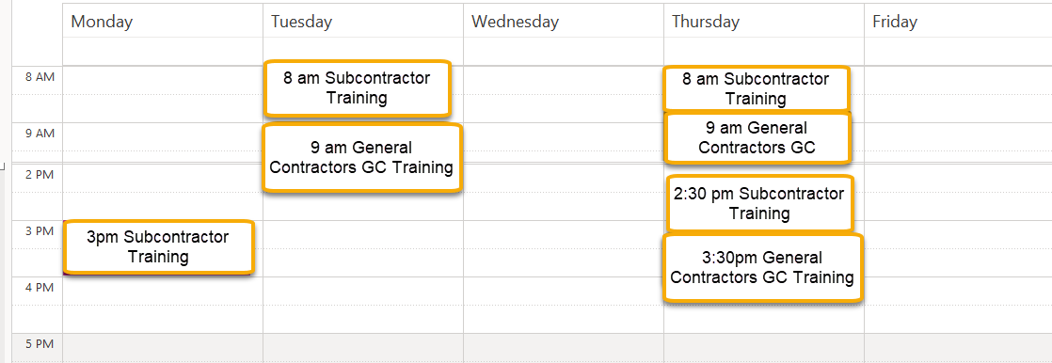
Weekly Training Schedule
Weekly Trainings will be booked: Monday Subs 3pm, Tuesday Subs 8 am & GCs 9 am & Thursday Subs 8 am & 9 am GCs & Subs 2:30pm & GC 3:30pm GCs

Slide 4
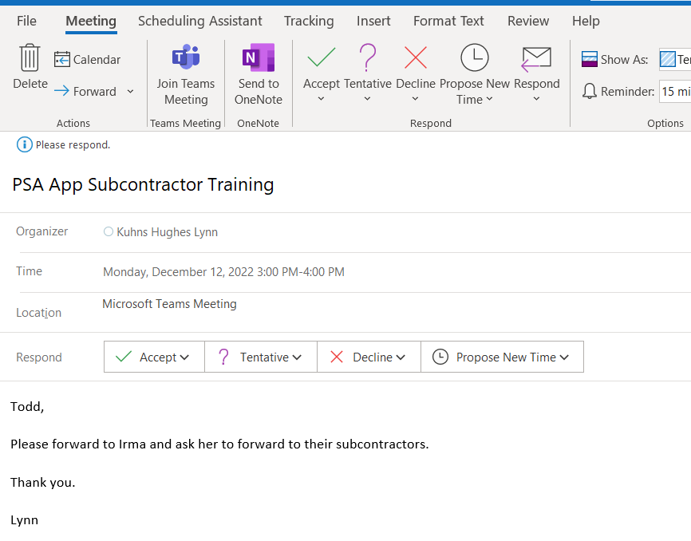
Invitation sent to PSA Specialist to
Forward to GCs
Specialist will forward invitation to GC Project Manager responsible to forward to their Subcontractors & Sub-Tiers

Slide 5
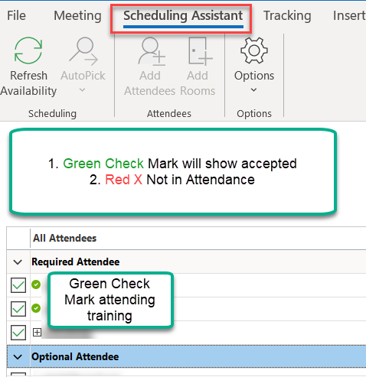
Sign-up list from Schedule Assistant
From open invitation, Schedule Assistant will display “green check’ mark for attending & “red x” will be not in attendance.

Slide 6
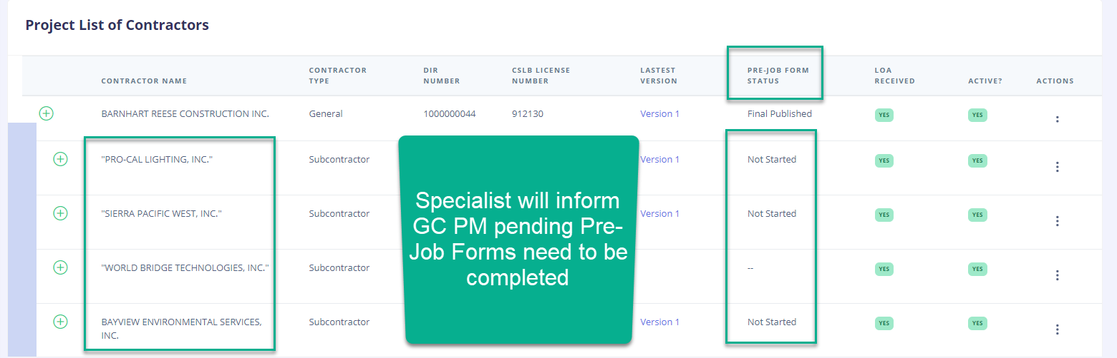
Monitor & Record of Sign-ups for Training & PreJob Forms not submitted
Trainer will capture sign-ups & email to PSA Specialist & GC Project Manager for record
Subcontractors or Sub-tiers not in attendance will be responsibility of GC Project Manager follow-up & enforce attendance
Specialist will communicate with GC Project Manager the status of pending Pre-Job Forms not completed

Slide 7
QUESTIONS

